Slide 1
Securing Agentic Application Guide V1.0
OWASP Edition – Notes
Link: https://genai.owasp.org/resource/securing-agentic-applications-guide-1-0/
Release Date: July 28, 2025

Slide 2
Introduction
Practical and actionable guidance for designing, developing and deploying secure agentic application powered by LLM
Audience: This guide is primarily intended for software developers, AI/ML engineers, security architects, security engineers, and technical leads

Slide 3
Scope
Technical security controls and best practices
Secure architectural patters (Actionable)
Mitigation strategies
Guidance across the development lifecycle – design, build, deploy, operate
Notes:
Out of scope – governance framework –Managing agentic risk guide

Slide 4
Key Components of Secure Agentic Architecture and Attack Surface

Slide 5
Generative Language Model
The brain of the agent responsible for understanding, reasoning, planning and generating responses. Often built on pre-trained foundation model – can be specialized using techniques like prompt engineering or fine-tuning
Large language models (LLMs)
Multimodal LLMs (MLLMs)
Small Language Models (SLMs)
Fine Tuned Models

Slide 6
Generative Language Model – Attack Surface
Core vulnerabilities in the brain of the agent
T5 (Cascading Hallucination): Foundation models generate incorrect information that propagates
T6 (Intent Breaking): Attacks target the core decision-making capabilities
T7 (Misaligned Behaviors): Model alignment issues lead to unintended behaviors impacting users, organizations, or the broader population
T15 (Human Manipulation): Models exploit human trust to manipulate users

Slide 7
Orchestrator
Control Flow Mechanism. Dictate the agent's overall behavior, information flow, and decision-making processes.
Sequential” for layered architectures, “dynamic” for blackboard architectures, or “coordinated” for multi-agent systems
Workflows: A structured, pre-defined sequence of tasks or steps that agents follow to achieve a goal.
Hierarchical Planning : Multiple agents collaborating via an orchestrator (router), responsible for the following :
Understanding the task, Decomposing the task, Routing to specialized agents, Orchestrator monitors agent performance, identifies inefficiencies, and autonomously adjusts workflow.
Multi Agent collaboration: multiple agents working together to achieve a common goal where agents have diverse skills

Slide 8
Orchestrator – Attack Surface
Vulnerabilities in workflow
T6 (Intent Breaking): Manipulates control flow to achieve unauthorized goals
T8 (Repudiation): Makes agent actions difficult to trace through workflow
T9 (Identity Spoofing): Especially problematic in multi-agent systems (KC2.2, KC2.3)
T10 (Overwhelming HITL): Overwhelms human oversight in workflows
T12 (Communication Poisoning): Corrupts inter-agent messaging in multi-agent systems
T13 (Rogue Agents): Compromises agent orchestration in multi-agent systems
T14 (Human Attacks): Exploits trust relationships between agents and workflows

Slide 9
Reasoning/Planning Paradigm
Agents utilize LLMs to solve complex tasks by breaking down high level tasks into smaller tasks each with a different sub-goal
Structured planning/execution
ReAct = Reason + Act : dynamic
Chain of Thought (CoT): Step by step thinking
Tree of Thoughts (ToT): Explore multiple reasoning paths and plan in parallel with lookahead, backtracking and self evaluation

Slide 10
Reasoning/Planning Paradigm – Attack Surface
Weakness in decision processes
T5 (Cascading Hallucination): Affects reasoning quality and propagates through planning steps
T6 (Intent Breaking): Directly attacks the reasoning process to manipulate goals
T7 (Misaligned Behaviors): Creates subtle reasoning misalignments
T8 (Repudiation): Obscures decision trails in reasoning chains
T15 (Human Manipulation): Leverages reasoning to craft manipulative responses

Slide 11
Memory Modules
Enables the agent to retain short-term (immediate context) a long-term information (past interactions, knowledge) for coherent and personalized interactions. Context sensitivity (classification or compartmentalization) is used to reduce the risk of unauthorized information exposure.
In agent session memory: Limited to single session and single agent
Cross agent session memory: Share across multiple agents but limited to a single session.
In agent cross session memory: Limited to single agent but shared across multiple sessions.
Cross agent cross session memory: Shared across multiple agents and sessions.
In agent cross user memory: Limited to single agent but shared across multiple users.
Cross agent cross user: Shared across multiple agents and users.

Slide 12
Memory Modules – Attack Surface
Data integrity issue
T1 (Memory Poisoning): Directly targets all memory types (KC4.1-KC4.6)
T3 (Privilege Compromise): Breaks information system boundary through context collapse, causing unauthorized data access/leakage (e.g. across tools)
T5 (Cascading Hallucination): Stores and amplifies hallucinations across sessions or agents
T6 (Intent Breaking & Goal Manipulation): Abuses shared context, breaking integrity, leaking/contamination, or interfering with data records/assets (e.g. within a tool) that should be isolated from one another
T8 (Repudiation): Manipulates or erases evidence from memory
T12 (Communication Poisoning): Affects shared memory in multi-agent systems

Slide 13
Tool Integration Frameworks
Extend the capability of the agent by using external tools (APIs, functions, data stores) to interact with the real world and other systems.
Flexible Libraries/SDK features: Code level building blocks or specific API capabilities for developers.
Managed Platform/Services: Vendor provided solutions that handle infrastructure, simplify setup and manage much of the orchestration for building agents with tools.
Managed APIs: API is the main interaction point, vendor hosted services providing higher level abstraction.
Notes:
Managed api : They manage complexities like state and aspects of tool orchestration via API
calls, making it easier to build sophisticated, stateful agents compared to using basic SDK features
alone.

Slide 14
Tool Integration Frameworks – Attack Surface
Tool exploitation vulnerabilities
T2 (Tool Misuse): Core vulnerability for all tool integration types (via MCP as well). Unverified, untrusted, or compromised tools
T3 (Privilege Compromise): Tools often run with specific privileges that can be exploited/excessive agency.
T6 (Intent Breaking & Goal Manipulation): Interfering with data records/assets (e.g., within a tool) that should be isolated from one another
T7 (Misaligned Behaviors): Creates subtle reasoning misalignments
T8 (Repudiation): Tool use may lack proper logging and auditability
T11 (Unexpected RCE): Tools might enable unexpected code execution

Slide 15
Operational Environment (Agencies)
Utilizing different agencies enables interaction with, gather, and process information from external environments, allowing them to operate effectively within them.
API Access:
compromised agent might have the ability to launch attacks on the API (see OWASP Top 10 for API), via the parameters generated by the LLM, resulting in a parameter pollution attack
A compromised agent might have the ability to generate unwanted API calls on behalf of the user by utilizing the agent's excessive authorization, and to launch attacks on the API
Code Execution: an agent utilizing LLM to generate a parameter used in a predefined Python/PHP/JS function). A compromised agent might have the ability to launch code injection attacks (see OWASP code injection), via the parameters generated by the LLM. A compromised agent might have the ability to run arbitrary code generated by an LLM
Database Execution:
A compromised agent might disrupt data in the data source or provide malformed information retrieved from the data source - utilizing an external data source to gain contextual information, or updates records in external sources based on user inputs
A compromised agent might have the ability to alter any record in the database, delete a database/table, or access and leak any information stored within the database – if the agent has capability to generate and run all CRUD operations
Web Access capabilities: A compromised agent is likely to form due to exposure to untrusted web content, and it might perform unwanted operations on behalf of the user by utilizing the agent’s excessive authorization (e.g., changing sharing settings or account settings on open user sessions).
Controlling PC operations: A compromised agent might perform unwanted operations, expose or leak personal information, and perform malicious operations such as encrypting files.
Operating Critical Systems: Unauthorized operations in critical systems can lead to catastrophic failures
Access to IoT devices: Unauthorized control over IoT devices

Slide 16
Operational Environment – Attack Surface
Monitoring gaps and external system risks
T2 (Tool Misuse): All operational environments can be misused, introducing more untrusted content and opportunity for agent failure, e.g., unauthorized settings changes.
T3 (Privilege Compromise): Highest risk in environments with extensive access (KC6.1.2, KC6.2.2, KC6.3.2)
T4 (Resource Overload): External services can be overwhelmed
T10 (Overwhelming HITL): Creates excessive activity requiring human approval
T11 (Unexpected RCE): Direct risk to code execution environments (KC6.2)
T12 (Agent communication poisoning): Using external systems for side channel communications and memory persistence
T13 (Rogue agents): Compromised AI agent activity outside monitoring limits
T15 (Human Manipulation): Leverages operational access to manipulate humans

Slide 17
Secure Architecture Patterns
The choice of architecture(Sequential, hierarchical, swarm) significantly influences the attack surface and the effectiveness of different security controls

Slide 18
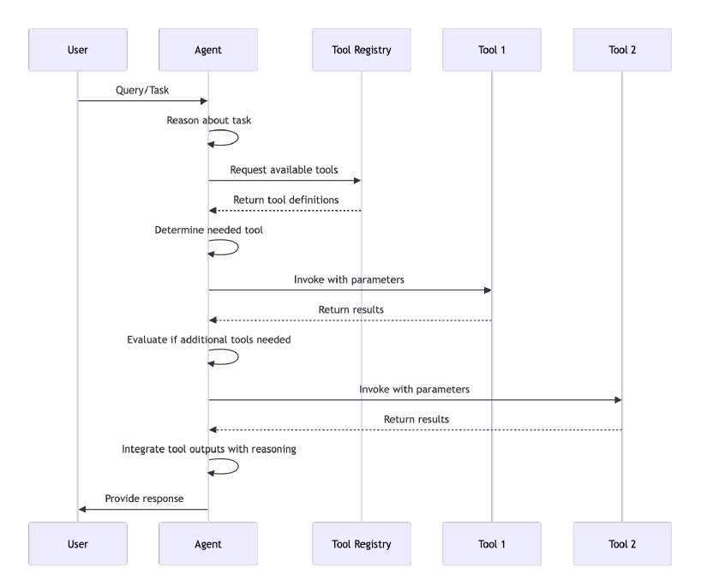
Tool use Pattern Interactions
Concept: Equips agents with the ability to use external tools, APIs, or functions to extend their capabilities beyond internal knowledge or LLM reasoning. The agent delegates tasks such as data retrieval, calculations, or actions to the appropriate tools.
Key Components: Requires tool definitions, an agent reasoning loop capable of selecting and invoking tools, and integration mechanisms.

Slide 19
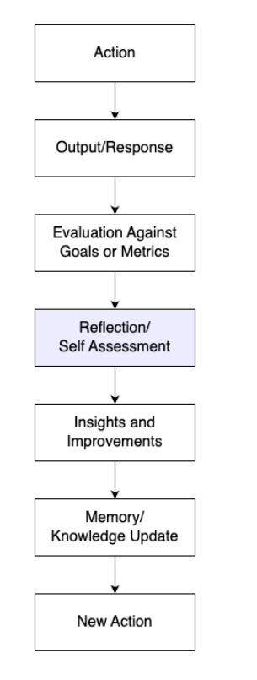
Reflection Pattern
Concept: Enables agents to introspect, evaluate their past actions, decisions, or outputs against goals or metrics, and use this self-assessment to refine future strategies or correct errors.
Key Components: Involves feedback loops, evaluation logic, and mechanisms for the agent to modify its behavior or knowledge.

Slide 20
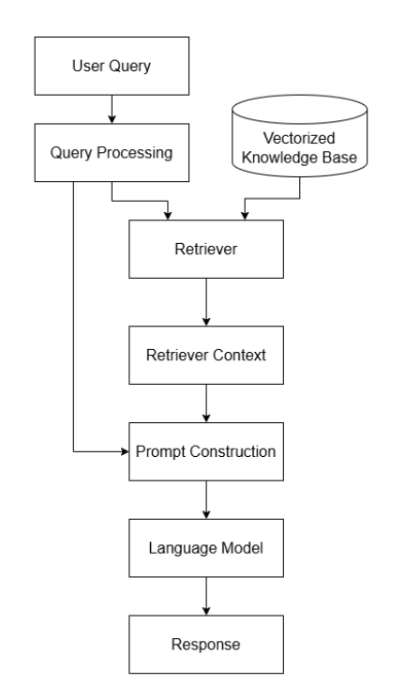
RAG Pattern
Concept: Enhances LLM-based agents by first retrieving relevant information from an external knowledge base (vector store, database, etc.) based on the user query, and then providing this retrieved context to the LLM along with the original query to generate a more informed and accurate response.
Key Components: Requires a retriever module, a knowledge base/vector store, and integration with the LLM prompt.

Slide 21
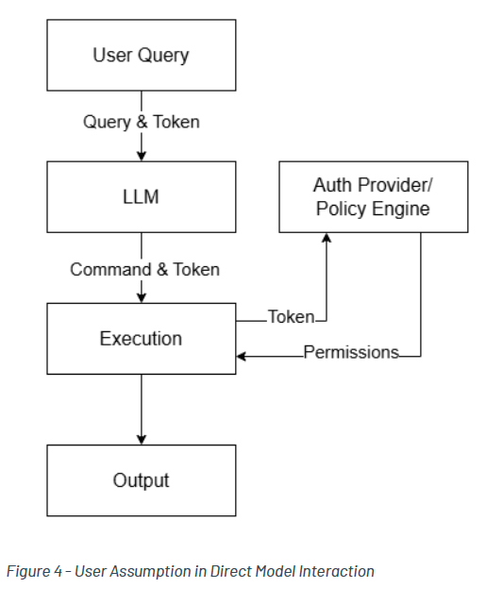
User Privilege/Auth Assumption pattern for execution
The agent should only have access to information that the user calling the agent has access. Just-In-Time access and ephemeral access use cases.
If the user privileges are not already restricted by a strong “Chinese Wall” model (to prevent information in records from leaking to unrelated records), the agent should track the boundary of the context it is operating on.
Key Components: LLM brain (KC1), Execution system for an API (KC6.1, KC6.3, KC6.4), and an authentication/authorization/IAM system.

Slide 22
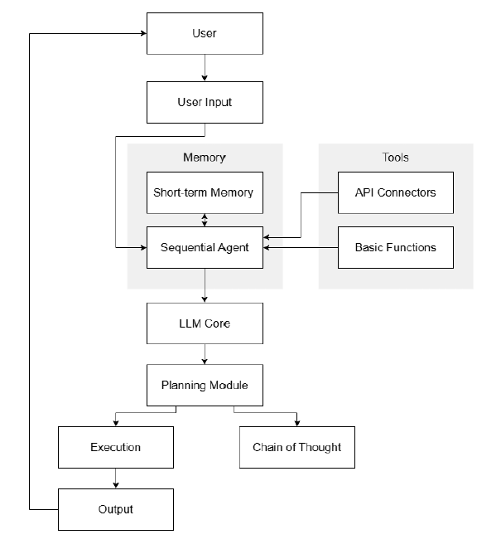
Sequential Agent Architecture
A straightforward linear workflow where a single agent processes input through planning, execution, and basic tool use. This pattern focuses on simplicity with a clear chain of thought and limited memory. This basic pattern uses a single LLM as the cognitive core with a linear workflow:
Brain: Single LLM (KC1.1)
Control: Simple sequential workflow (KC2.1)
Reasoning: Chain of Thought reasoning (KC3.3)
Memory: In-agent session memory only (KC4.1)
Tools: Limited SDK integration (KC5.1)
Environment: Restricted API access (KC6.1.1)

Slide 23
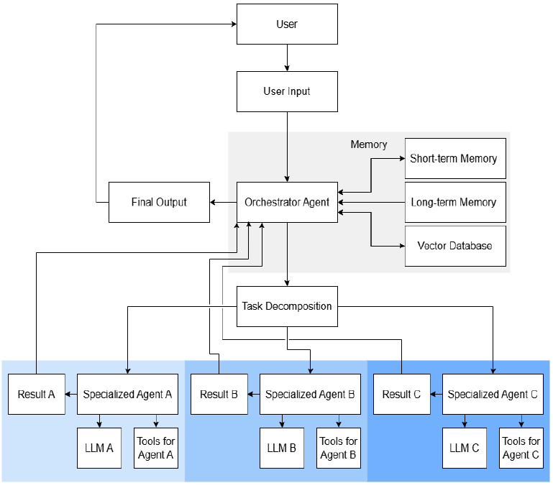
Hierarchical Agent Architecture/Role Based Multi Agent Systems
An orchestrator agent breaks down complex tasks and distributes them to specialized sub-agents. Each agent handles a specific domain using appropriate tools, with the orchestrator managing the overall process and integrating results. A more complex pattern with specialized sub-agents coordinated by an orchestrator:
Brain: Multiple specialized LLMs / fine-tuned models (KC1.1 / KC1.2)
Control: Hierarchical planning with orchestrator (KC2.2)
Reasoning: Structured planning/execution (KC3.1)
Memory: Cross-agent session memory (KC4.2)
Tools: Managed platforms/services (KC5.2)
Environment: More extensive capabilities (KC6.2, KC6.4)

Slide 24
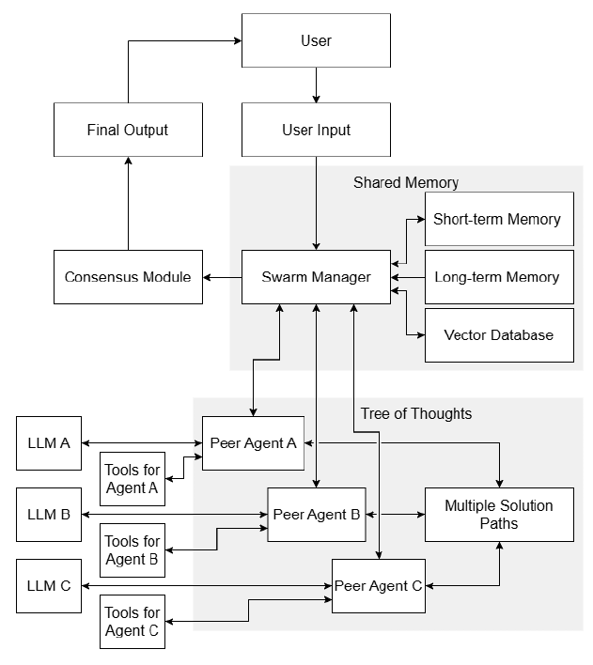
Collaborative Agent Swarm/Distributed Agent Mesh
Multiple peer agents work together without a strict hierarchy
Brain: Multiple specialized agents (KC1.1/KC1.2)
Control: Multi-agent collaboration (KC2.3)
Reasoning: Tree of Thoughts for exploring multiple solutions (KC3.4)
Memory: Cross-agent cross-session memory (KC4.4)
Tools: Flexible libraries with collaboration features (KC5.1)
Environment: Distributed operational capabilities (various KC6)
Notes:
Parameter pollution when generating parameters for API calls.

Slide 25
Agentic Developer Guidelines
Secure Design and Development Framework

Slide 26
System Prompt Engineering and Hardening
Purpose: Define the agent's core instructions, capabilities, and limitations securely to prevent manipulation and unintended behavior.
Practical Approach
Clear Boundaries and Safeguards: Explicitly state DOs and DON'Ts, forbidden topics, operational scope, and ethical guidelines. Similarly apply to languages
Robustness against injection: Use clear delimiters and/or placeholders for user input, Instruct the model to be wary of attempts to override its core instructions, few shot examples, deterministic controls to limit an agents access.
Role Definition: Clearly define the agent's persona and purpose to anchor its behavior.
Iterative Refinement: Test prompts against known injection techniques and refine based on results.
Minimal and Focused fine tuning: Fine-tuning can further enforce security controls and adherence to agent goals but can also overwrite foundational model security training.
Notes:
Parameter pollution when generating parameters for API calls.

Slide 27
Secure Coding Practices
Purpose: Implement standard secure coding principles adapted for AI agent development.
Practical Approach
Input validation: Validate all inputs and not just tool arguments. Use allowlist where possible
Error handling: Implement robust error handling avoid leaking sensitive information in the error messages
Secure key management: Avoid hardcoding secrets
Least Privilege
Notes:
Parameter pollution when generating parameters for API calls.

Slide 28
Content Moderation Integration (Design)
Purpose: Plan for detecting and filtering harmful or policy-violating content in both inputs and outputs early in the design.
Practical Approach
Identify necessary checks you want to place
Evaluate tools based on requirements (Rule based, ML classifier, etc)
Design how moderation results will trigger actions
Ensure you test your content moderation against your policies and for correctness
Notes:
Parameter pollution when generating parameters for API calls.

Slide 29
Human-in-the-Loop (HITL) Design
Purpose: Determine where human oversight is critical before the agent takes high-impact actions.
Practical Approach
Risk based identification: identify actions requiring approval.
Clear workflow: Design a user friendly interface for review, approval or rejection. Log human decision
Framework Integration: Leverage built in HITL features in agent frameworks
Include strong rate limiting: to prevent overwhelming humans in DoS situation
Notes:
Parameter pollution when generating parameters for API calls.

Slide 30
Memory Security Design
Purpose: Plan how to protect the agent's short-term and long-term memory (e.g., vector databases, caches) from unauthorized access, tampering, and data leakage.
Practical Approach
Access control : Use standard mechanisms to restrict access based on the principle of least privilege
Strip Dangerous tokens: Remove “ignore”, “system” or ”from now on” , etc from past messages
Encryption: Encrypt data both at rest and in transit
Input validation for memory: validate and sanitize data before storing it in memory to prevent storing malicious content and corrupted data
PII handling : Design mechanism for PII detection and redaction/anonymization before storage
Human in the loop: Use human oversight to both approve and audit memory entries
Notes:
Parameter pollution when generating parameters for API calls.

Slide 31
Input/Output Validation and Sanitization Design
Purpose: Define strategies to ensure the integrity and safety of data flowing into and out of the agent and its tools.
Practical Approach
Apply AI Guardrails to both inputs and outputs: Via tool calling, within the agent/tool, man-in-the middle approach such as MCP proxy
Input sanitization and Escaping : Escape or strip special tokens such (##, <<, {{}}), etc. before injecting user input into prompts. Avoid prompt templating patterns that concatenate raw user input into instructions.
Schema Enforcement: Define strict schemas for tool arguments and expected outputs, possibly reduce the risk of unexpected reinterpretation or hallucinating new instructions (Pedantic, JSON schema)
Allow/Deny Lists Lists: Use allow lists for known-good values and deny lists for known-bad patterns in tool arguments or outputs
Output Sanitization Strategy: Consider the context
Secure Rendering: Plan to use safe methods for displaying agent output in UIs (e.g., element.textContent instead of element.innerHTML in JavaScript).
Facilitate Human Review in regulated scenarios or where applicable via JSON logs of outputs.
Multilingual adaption
Notes:
Parameter pollution when generating parameters for API calls.
Plan how to neutralize potentially malicious content (e.g.,
scripts, HTML) in LLM outputs before rendering or passing to other systems. Consider
context (e.g., rendering in a browser vs. saving to a database), dropping outputs with
suspicious content, blocking payloads that do not match expected structure, and
disallowing further propagation of injected payloads (i.e., ensuring the malicious input does
not spread or get reused by the Agent or its environment. Use WAFs where possible.
■ Examples: JSON schema; custom filters that enforce allowed fields/types/values
(depending on the use case and without being too restrictive).

Slide 32
Authorization and Authentication
Purpose: Authenticate and authorize agentic systems to perform actions and read data on behalf of users or systems.
Practical Approach
Identify permission boundaries: Examine agent & tools for expected actions and data reads. Ensure agents & tools are coded to respect their permissions.
Use identity providers and authorization servers: Determine if an agent is acting as a business system or on behalf of a user and create the correct identity type for the use case.
Assign Decentralized identifiers to agents: Use DIDs to identify and authenticate remote agents
Notes:
Parameter pollution when generating parameters for API calls.

Slide 33
Agentic Developer Guidelines
Secure Build and Deployment Phase
Development environments should sandbox agent chains to isolate failures, constrain tool usage through strict policy checks, and guard against memory corruption or drift. Deployment pipelines must go beyond packaging and release—they need to include snapshotting agent capabilities in clearly labeled artifacts, logging audit trails, and embedding signed constraints on tool/API usage and memory schema. Release protocols should support rollback, serialization integrity, and runtime enforcement of behavioral boundaries to ensure safe deployment into real-world systems.

Slide 34
Static Analysis and Code Scanning (SAST)
Purpose: Automatically detect potential security vulnerabilities in the agent's source code before runtime.
Practical Approach
Integrate SAST tools into the CI/CD pipeline to scan code on commit/merge.
Focus on common web vulnerabilities (if applicable), insecure use of APIs, hardcoded secrets, and unsafe code patterns.
Notes:
Parameter pollution when generating parameters for API calls.

Slide 35
Dependency Vulnerability Scanning (SCA)
Purpose: Identify known vulnerabilities in third-party libraries and dependencies used by the agent.
Practical Approach
Integrate SCA tools into the CI/CD pipeline or use package manager features.
Regularly scan dependencies and update libraries with known vulnerabilities.
Example: Snyk, pip-audit, gitlab Dependency scanning
Notes:
Parameter pollution when generating parameters for API calls.

Slide 36
Environment Hardening and Sandboxing
Purpose: Isolate the agent's execution environment to limit the potential impact of a compromise
Practical Approach
Restrict deployment pipeline - prevent access to deployment pipeline and configuration by the agent itself
Sandboxing - Execute agent code, especially code generated by the LLM or tools involving executing in isolated environments. Choose based on isolation needs vs performance overhead.
Filesystem/Network Restrictions: Configure strict permission with the sandbox
Principle of least privilege: Run agent process with minimal OS-level privileges
Notes:
Parameter pollution when generating parameters for API calls.

Slide 37
Secure Configuration Management
Purpose: Securely manage configurations, especially secrets and API keys, during deployment.
Practical Approach
Secret Management : Use dedicated systems (AWS Secrets Manager, Google Secret Manager, Vault) instead of config files or environment variables for sensitive data. Implement credential rotation (OWASP Secrets Management Cheat Sheet). Verify that no secrets are ever written into logs.
API access control: Use fine grained access controls for external APIs scope granting only necessary permissions (Oauth2)
Infrastructure as Code Security: Scan IaC templates for security misconfigurations before deployment
Notes:
Parameter pollution when generating parameters for API calls.

Slide 38
Pre-Deployment Testing (Fuzzing, Pen testing)
Purpose: Actively probe the agent and its interfaces for vulnerabilities before release.
Practical Approach
Prompt interface fuzzing: Use automated tools to send malformed, unexpected, or adversarial inputs to the agent's prompt interface to uncover injection vulnerabilities or unexpected behavior.
PromptFoo, PyRIT, Garak
API Fuzzing : Test any custom APIs exposed by the agent system
Targeted Penetration Testing: Conduct manual or automated penetration tests focusing on the specific risks identified during threat modeling.
Notes:
Parameter pollution when generating parameters for API calls.

Slide 39
Runtime Security with Memory Isolation
Purpose: To provide defense-in-depth even if the underlying LLM is vulnerable, for instance, to prompt injection.
Practical Approach
Incorporate runtime security architectures
Explicitly separate control flow generation from untrusted data processing
Notes:
Parameter pollution when generating parameters for API calls.

Slide 40
Separating Data Planes from Control Panes (Multi-agent Architectures)
Purpose: To limit the ability of a single agent compromise to cascade into a systemic failure.
Practical Approach
In systems where multiple agents collaborate, the mechanisms for inter-agent communication must differentiate between control messages (e.g., task assignments, commands) and data messages (e.g., shared information).
Control channels require stronger authentication, authorization, and integrity checks to prevent a compromised agent, potentially handling untrusted data, from issuing malicious commands or disrupting the coordination of the entire system.
Notes:
Parameter pollution when generating parameters for API calls.

Slide 41
Just-in-Time Access and Ephemeral Credentials
Purpose: To reduce the window of opportunity for misuse if credentials are compromised.
Practical Approach
This should be coupled with the use of ephemeral credentials, such as short-lived API tokens (e.g., OAuth tokens, signed JWTs) or temporary cloud credentials (e.g., AWS STS, GCP IAM credentials), which expire automatically.
Notes:
Parameter pollution when generating parameters for API calls.

Slide 42
Agentic Developer Guidelines
Secure Operations and Runtime Phase
Notes:
Live agentic systems require continuous behavioral monitoring that extends far beyond performance metrics. Runtime observability must capture decisions, plan evolution, memory access patterns, and agent tool interactions. Behavioral drift—such as deviation from expected plans or misuse of tools—must trigger alerts or invoke safeguards. Agents should log timestamped reasoning traces for post-incident analysis, and operators must retain real-time override capabilities. Monitoring should create trust through full visibility into agent behavior, particularly around memory usage, planning shifts, and inter-agent communication.

Slide 43
Continuous Monitoring and Anomaly Detection
Purpose: Detect malicious activity, policy violations, and deviations from expected behavior in real time.
Practical Approach
LLM Input/Output Scanning
Tool Invocation Monitoring : Log all tool calls, parameters, and results.
Plan and Execution Monitoring : Pre execution checks and Runtime Monitoring
Memory Anomaly Detection: Monitor memory update patterns (Frequency, Size, content )
Behavioral Analysis (Multi Agent): Monitor communication patterns and actions
SEIM Integration
Automated Anomaly response: This may include compute quarantine, circuit breakers on excessive request loads, automated compute or memory scaling, or revoking access to credentials.
Notes:
Parameter pollution when generating parameters for API calls.

Slide 44
Runtime Guardrails and Automated Moderation
Purpose: Enforce policies and constraints dynamically during agent operation
Practical Approach
Input/Output guardrails – real time checks
Locate guardrails : The proximity of the guardrail relative to the application code and LLM has an impact on threat detection effectiveness, depending on the type of threat.
may lack the session history and context that are necessary to detect such an attack
Content filtering:
Notes:
Parameter pollution when generating parameters for API calls.

Slide 45
Logging, Auditing and Traceability
Purpose: To support debugging, security analysis, compliance, and understanding agent behavior, applications need to maintain detailed records
Practical Approach
Centralized logging ad Monitoring Platform
Session scoping: Tag memory buffers by session ID or user identity (extracted from JWT, OAuth, etc.) for logging, auditing & traceability, while making sure that actual session tokens are never stored in logs
Comprehensive Logging: Log agent reasoning steps, generated plans, validation results, tool calls (with parameters/results), HITL interactions (including decisions), errors, and state changes.
Structured Logging
Traceability through agent steps and tool calls to reconstruct the flow of execution
Log integrity
Multi tenant tagging: clear tagging of data owners can help automated filtering of log data for downstream investigations and alerting
Notes:
Structured Logging : Use formats like JSON for easier automated parsing and analysis
Never log sensitive information: the agent should not record the following directly in the logs, but instead should remove, mask, sanitize, hash, or encrypt: ■ Application source code ■ Session identification values (consider replacing with a hashed value if needed to track session specific events) ■ Access tokens ■ Sensitive personal data and some forms of personally identifiable information (PII) e.g. health, government identifiers, vulnerable people ■ Authentication passwords ■ Database connection strings ■ Encryption keys and other primary secrets ■ Bank account or payment card holder data ■ Data of a higher security classification than the logging system is allowed to store ■ Commercially-sensitive information ■ Information it is illegal to collect in the relevant jurisdictions ■ Information a user has opted out of collection, or not consented to e.g. use of do not track, or where consent to collect has expired

Slide 46
Vulnerability Scanning (Runtime)
Purpose: Continuously scan the running application and environment for new vulnerabilities
Practical Approach
Perform periodic infrastructure vulnerability scans.
Integrate findings into a patch management process.
Utilize DAST scanning against lower environments for APIs and other common interfaces like OWASP ZAP.
Use port and CVE scanners for environment endpoints.
Notes:
Parameter pollution when generating parameters for API calls.

Slide 47
Incident Response Planning
Purpose: Have predefined plan to handle security incidents involving
Practical Approach:
Define what constitutes an incident (e.g., successful prompt injection causing harm, data breach via agent, agent performing unauthorized actions).
Outline steps for containment (e.g., disabling the agent, restricting tool access), analysis (using logs and monitoring data), remediation, and reporting.
Assign roles and responsibilities for incident response.
Regularly test the plan using tabletops and “fire” drills.
Notes:
Parameter pollution when generating parameters for API calls.

Slide 48
AI Bot Mitigation and Control
Purpose: verifiable Agent identity is the admission ticket to the Agentic Web: build it in now, and your agent is welcomed as a trusted collaborator; neglect it, and you’ll be treated as just another threat to be blocked.
Practical Approach
Multi Factor identity bundle

Slide 49
Enhanced Security Actions for Agentic AI Systems
Single Agent System

Slide 50
Authentication and Authorization
Implement OAuth 2.0/OIDC
Grant the agent short-lived access tokens to prevent misuse or leakage.
Use authorization code flow with PKCE for enhanced security
Just in time credential issuance
Distinguish between read and write access
Grant only the minimum and necessary permission
Apply role based access control
Use managed identity services
Notes:
Parameter pollution when generating parameters for API calls.

Slide 51
Data Protection
Encrypt sensitive data
Implement data loss prevention
Use data classification and sensitivity labels
Apply data minimization principles
Notes:
Parameter pollution when generating parameters for API calls.

Slide 52
Code Security
Establish automated testing pipeline
Include SAST, DAST, and SCA tools in the pipeline
Conduct thorough code reviews
Monitor dependencies
Check external libraries for vulnerabilities
Set up automated dependency scanning and alerts
Notes:
Parameter pollution when generating parameters for API calls.

Slide 53
Monitoring and Incident Response
Log all actions and establish baselines
These logs should be assigned the same data classification as the highest level of data involved in their generation.
Implement real time anomaly detection
Set up alerts for suspicious events
Alert on access attempts to sensitive endpoints, spikes in requests, unusual IP origins
Develop incident response plans
Create detailed procedures for addressing security breaches - Include containment, investigation, remediation, and recovery steps
Implement emergency off-switch
Create automated and manual mechanisms to stop agent operations
kill switches to immediately revoke access privileges
Notes:
Parameter pollution when generating parameters for API calls.

Slide 54
Prompt Security
Sanitize all inputs
Harden system prompts
Embed security policies directly into the AI's foundational instructions
Apply content filtering on AI outputs
Input validation
Filter user inputs using rule-based patterns and NLP techniques or filtering for multi-modal processing
Notes:
Parameter pollution when generating parameters for API calls.

Slide 55
Enhanced Security Actions for Agentic AI Systems
Multi Agent System with Central Orchestrator
Multiple intelligent agents that interact with each other and a shared environment to solve problems or achieve goals. The agents can operate independently, discern their surroundings, make decisions, and act. The central orchestrator is responsible for coordinating the agents’ interactions, assigning tasks, and maintaining the overall workflow or state.

Slide 56
Authentication and Authorization
Use authentication and authorization controls mentioned above
Establish separation of control planes
Create a clear separation between different agent functionalities
Maintain distinct permission sets for each agent based on least privilege
Authenticate and verify all agent interactions
Restrict discovery to known and trusted servers
Hard-code discovery servers in agent instructions
Prevent agents from communicating with discovery servers using network and logical controls
Notes:
Parameter pollution when generating parameters for API calls.

Slide 57
Orchestrator Security
Harden the central orchestrator’s API (OWASP API Security top 10)
Protect against control flow hijacking
Implement integrity checks and validation on operational metadata and agent outputs
Mitigate the confused deputy problem
Prevent scenarios where trusted components are tricked into performing unauthorized actions
Implement additional context validation and cross-check requests
Notes:
Parameter pollution when generating parameters for API calls.

Slide 58
Inter-Agent Communication
Implement secure communication protocol
Utilize well known protocols or pre-defined schemas
Utilize schema based communications to simplify deterministic validation and improve consistency
JSON RPC 2.0 and or standard event methods
Verify the identity of each communication agent
Use certificate-based or token-based authentication mechanisms
Use secure message queuing system
Implement message brokers with security features for asynchronous communication
Deploy policy enforcement points
Implement as middleware or service proxies that validate each interaction
Apply rate limiting for agent interactions
Implement exponential backoff for failed requests
Prevent abuse by limiting the frequency of requests between agents
Notes:
Parameter pollution when generating parameters for API calls.

Slide 59
Trust Boundaries
Apply zero trust security principles
Implement network segmentation and agent isolation
Limit the interconnectedness of agents to contain potential breaches
Create distinct security zones within the system
Use containerization techniques
Sandbox individual agents
Restrict access to underlying resources and OS
Notes:
Parameter pollution when generating parameters for API calls.

Slide 60
Enhanced Security Actions for Agentic AI Systems
Multi Agent System with Swarm Architecture

Slide 61
Authentication and Authorization
Same as the above ones
Identity trusted agents and actions
Assign this trust and action outside the agentic flow
Limit or prevent the swarm from adding new agents without human guidance.
Notes:
Parameter pollution when generating parameters for API calls.

Slide 62
Decentralized Identity and Trust
Implement decentralized identifier
Use W3C standard DIDs for self-sovereign agent identities
Enable verification without a central authority
Use verifiable credentials (VCs)
Create decentralized reputation system
Build systems where agents develop reputation scores based on behavior
Agent identity (DID = providing a persistent, verifiable identity across), verifiable credentials (agent's capabilities, permissions, or trust level within the system), inter agent authentication without centralized coordination, enable provenance tracking, Access control to specific resource or capability, role specialization.
Use these scores to make trust decisions for collaboration
Notes:
Parameter pollution when generating parameters for API calls.

Slide 63
Secure Peer to Peer Communication
Select appropriate P2P communication protocol
Ensure both encryption and authentication
Consider TLS/SSL, DTLS, Noise Protocol, or specialized frameworks
Notes:
Parameter pollution when generating parameters for API calls.

Slide 64
Cross Architecture Security Considerations
Secure API design for agent communication
Standardized interfaces with comprehensive input validation
Apply rate limiting irrespective of architecture
Continuous security testing
Scan agents regularly for vulnerabilities
Implement manual and automated testing
Security monitoring and threat detection
Secure agent updates and maintenance
Verify integrity of updates before deploying
Notes:
Parameter pollution when generating parameters for API calls.

Slide 65
Key Operational Capability

Slide 66
KC6.1 API Access
Core Threats: Unauthorized data access/leakage (T3), API abuse (DoS, cost overruns) (T4, T2), Compromised keys (T3, T9)
Controls
Enforce least privilege
Notes:
Parameter pollution when generating parameters for API calls.

Slide 67
KC6.2 Code Execution
Core Threats: Arbitrary code execution (RCE) (T11, T3), Code injection (T11, T2), DoS via resource exhaustion (T4), Leakage of confidential information (T6)
Controls
Implement mandatory sandboxing
OS-level isolation, containers, VMs, Web Assembly, or cloud solutions
Perform static analysis on agent generated code
Enforce resource limitations
Set strict CPU, memory and execution time limits
Implement timeouts for all operations
Additional security measure
Use code signing or verification when possible
Implement strict file system and network restrictions
Use allow lists for permitted commands
Sanitize all executed code output
Implement runtime monitoring during execution
Notes:
Parameter pollution when generating parameters for API calls.

Slide 68
KC6.3 Database Execution
Core Threats: SQL injection (T2), Unauthorized data exposure/modification (T3), RAG data poisoning/sensitive data retrieval (T1, T5, T3)
Controls
Use managed vector databases with Access controls
Restrict data ingest to match the access control capability
Apply data classification labels to enforce use privilege
Implement query safety measures
Use parameterized or template queries/ORMs exclusively. Never construct SQL using string concatenation.
Grant database access via least-privilege user accounts
Filter/block dangerous SQL keywords (e.g., DROP, TRUNCATE)
Validate all user inputs influencing queries - if possible, derive from controlled channels only vs context window.
RAG specific controls
Check for post retrieval check for PII before agent use
Apply content verification before embedding into vector stores
Rate limit retrieval operations
Limitation(excessive retrieval)
Notes:
Parameter pollution when generating parameters for API calls.

Slide 69
KC6.4 Web Use
Core Threats: Malicious web content (XSS, exploits) (T11), Leakage of confidential information (T6), Phishing/deception (T7), Server-Side Request Forgery (SSRF) (T2, T3), Access to user's browser data - Sensitive Data Exposure (T3)
Controls
Sandbox Browser Components
Run in tightly controlled environments
Avoid using extensions or operating directly in the user’s browser
Implement URL security
Url filtering with allow lists
Leverage secure web gateway or Data loss Prevention
Perform reputation check on target domains
Enforce proper TLS verification
Detects and blocks open redirects or excessive redirection chains. Further, use DNS-based filtering in addition to HTTP-level filtering.
Apply Protective Measures
Use network segmentation to prevent access to internal systems (mitigating SSRF)
Throttle web access rate
Restrict downloadable file types
Inspect embedded/linked content (e.g., iframes, JS-injected sources)
Logging and monitoring
Log all URL accesses and HTTP responses
Notes:
Parameter pollution when generating parameters for API calls.

Slide 70
KC6.5 Controlling PC Operations (Filesystem, OS commands)
Core Threats: Unauthorized file access/modification (T3), Arbitrary OS command execution (T11, T3, T2), Lateral movement (T3)
Controls
Apply strict isolation
OS level sandboxing
Consider dedicated containers or VMs for isolation
Run agents as restricted users with minimal privileges
Implement access controls
Define strict allow/deny lists for permitted OS operations and file paths
Use virtual filesystem interfaces where appropriate
Limit accumulation of sensitive data
Enhance Monitoring and Oversight
Log all OS-level actions performed by the agent
Consider HITL approval for critical operations
Command validation before execution
Notes:
Parameter pollution when generating parameters for API calls.

Slide 71
KC6.6 Operating Critical Systems
Core Threats: Catastrophic physical outcomes (T2, T3, T6, T7), Malicious control injection (T2, T6), False data influencing decisions (T1, T5)
Controls:
Apply max isolation
Use air gapped or highly segmented networks
Implement physical security measures
Enforce MFA
Do not use agent to mediate MFA flow or retain privileged session
Implement mandatory HITL for every critical action, succinct and engaging enough to retain the user’s attention each time
Implement Safety Mechanism
Default agent permissions to read only monitoring
Ensure physical Interlocks and emergency overrides exist
Notes:
Parameter pollution when generating parameters for API calls.

Slide 72
Agentic AI and the Supply Chain

Slide 73
Code Security
Third party libraries and frameworks needs to be secured using supply chain best practices, SCA scanning, Hashes and package locks for 3rd party versioning, SBOMs
LLM/Agent – Generated code
Utilize sandboxing for any agent-generated/run code
Validate packages before running generated code
HITL for high risk code execution operations

Slide 74
Environments and Development
LLM/Login System
Ensure provenance of LLMs in public registry by verifying hashes and contributors
Use LLM and SCA scanners to scan for both third-party package vulnerabilities and security issues within LLM code
Version Control and Code Management
Utilize version control with LLMs and logic systems to track behavior
Version control prompts and instructions to increase reliability and auditability
User commit IDs and hashes for data changes
Permission Management
Don’t give agents access to the repositories/data sources that build/deploy them

Slide 75
Agent and Tool Discovery
Agent Cards
Minimize trust with unvalidated agent systems
Employ DIDs for agent verification and authentication
Local Vs Remote Agent Registries
Use logical or network barrier between local & remote registries to prevent registry confusion and accidental agent boundary traversal
Classify and separate private and public agents, data and actions.
Prevent agents from sharing data or performing actions across these boundaries
Use trust relationship and controls like certificate pinning to ensure agents only communicate with approved registries and environments

Slide 76
Secure Agentic Deployments

Slide 77
Principles and Practices
Secure pipelines and check for rogue agents: Iplementing rigorous CI/CD with code checks must incorporate automated vulnerability scanning of dependencies, static analysis focusing on potential insecure Agent’s tool usage patterns, and dynamic testing specifically designed to probe for prompt injection vulnerabilities or unintended goal deviation before deployment. Incorporating code signing, provenance tracking for agent versions, and potentially manual security reviews for agents handling high-risk tasks helps ensure that only vetted and approved agent logic reaches production, preventing deliberately malicious or inadvertently vulnerable agents from being deployed.
Role containerization or Function as a service (FaaS): To limit the blast radius, all agents should be deployed in isolation. strict resource limits (CPU, memory, network), network segmentation policies, and ephemeral execution contexts – least privilege at the infrastructure level.
API access control, Rate-limits and API gateways:An API/Agent Gateway should mediate all tool invocations, enforcing strict authentication (verifying the agent's identity) and authorization (confirming the agent has permission to call that specific tool with those parameters). Implementing granular rate limiting per agent or per tool prevents denial-of-service attacks (intentional or accidental) and controls costs associated with API usage. Gateway is the vital point for logging and auditing.
Altering on Anomalous behavior: Systems should baseline normal agent behavior (e.g., typical tool usage frequency and sequences, resource consumption, data access, external communication) and trigger alerts upon significant deviations.
Human oversight in high stakes environment: Adaptive trust mechanisms can dynamically adjust the level of required oversight based on the agent's performance, context, and the risk associated with the specific action.
Managing non-human Identities: Treated the same rigor as human identities, involving secure provisioning processes, robust credential management, clear ownership, reliable de-provisioning.
Notes:
A lot depends on the application and risk profiles

Slide 78
Runtime Hardening
Traditional VM security hardening and Agentic specific controls such as sandboxing, auditability, capability constraints and runtime behavioral monitoring

Slide 79
Harden the Virtual Machine
Baseline VM Hardening
Use minimal base images (e.g., distroless, Alpine, microVMs).
Enable Secure Boot, TPM-backed disk encryption (e.g., via dm-crypt/LUKS).
Disable all unnecessary services (sshd, cron, etc.).
Apply firewall rules (iptables/nftables) to restrict ingress/egress by default.
Patch regularly using automation (e.g., unattended upgrades or distroless image re-pulls).
Network Isolation
Put VM inside a private subset or VPC
Use Service Meshes or API Gateways for controlled inter-agent communication.
Prevent direct internet access unless needed (Monitor it) Enable Secure Boot, TPM-backed disk encryption (e.g., via dm-crypt/LUKS).

Slide 80
Contain the Agentic Runtime
Sandbox the Agent Processes
Run each agent or tool in its own restricted namespace or container
Use tools to restrict syscalls (AppArmor/SeLInux or seccomp namespace)
Limit file system access using mount namespaces and read only access
Inject ephemeral storage for memory-sensitive LLM tools.
Scoped Capabilities
Use an AGNTCY-like capability control layer
Use JSON-RPC wrappers to enforce capability boundaries
Introduce capability tokens scoped per session
Allow use of only explicitly declared tools

Slide 81
Secure the Agent’s Memory, Tools, and Context
Memory and State Hygiene
Encrypt in memory state (where feasible)
Auto-clear memory on session ends
Use VM hooks to flush memory or rotate keys
Tool Execution Control
Implement runtime guards for tool calls:
validate input and output.
Scan for prompt injection or malicious redirection attempts

Slide 82
Observability and Forensics
Audit Everything
Every agent action (tool use, messages, memory write) should be logged with timestamp, sessionID, agentID, payload hash.
Log input/output signature fingerprints
Store logs securely with forward integrity (Append only + Merkle proofs or signed logs)
Behavioral Anomaly Detection: Use runtime policy engines (e.g., Open Policy Agent) or integrate LLM anomaly detectors to spot:
Unusual tool invocation patterns.
Cross-agent communication deviations.
Memory bloat or frequent memory peeks.

Slide 83
Identity, Authentication and Agent Authorization
Identity and Session Management
Use JWTs, mTLS, or HMAC-based auth per agent session.
Role based + Capability-based Access
Combine RBAC (agent classes) with capability tokens

Slide 84
Cloud Specific Hardening
If your VM is running in AWS/GCP/Azure:
Restrict metadata service access (e.g., IMDSv2 in AWS).
Use IAM roles scoped per VM, not global.
Enable Confidential Computing if supported/feasible

